Slide 1


Memory Game
Bilkan Ulker, Devon Schroeder, Ethan Johnson, Nicholas Jarrett, Sullivan Kelley, Zachary Hunter

Slide 2
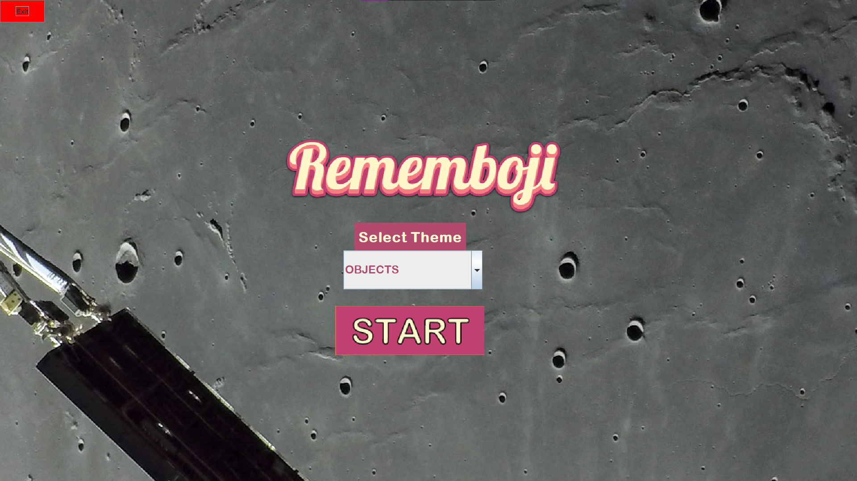
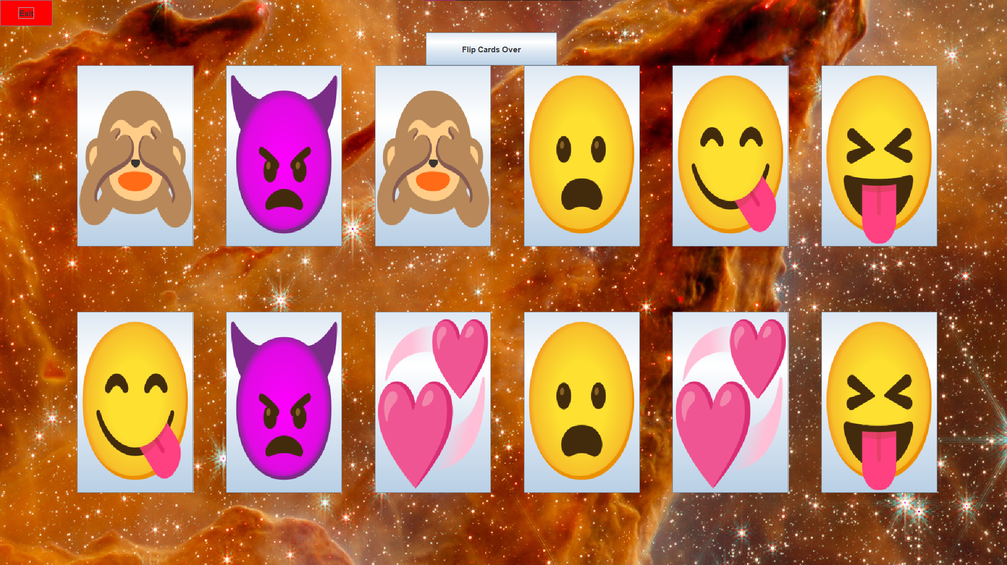
Goal
Create a game that tests the players memory by:
(1) Allowing players to pick a emoji category and starting the game. (2) Displaying a game board of matching card pairs face-up, allowing the player to study the layout, until they press the “Flip Cards” button, (3) Flipping the cards face-down and asking the player to select matching pairs, (4) Place incorrectly matched pairs face-down again until player finds all pairs, (5) Return the number of turns it took player to complete game.
Incorporate APIs for: (1) Game screen background (2) Emoji categories (3) Emojis on cards

Slide 3
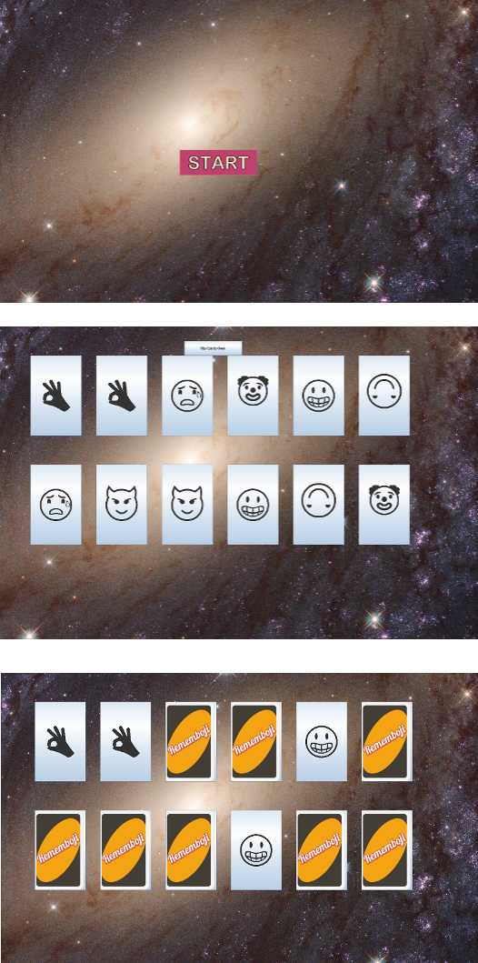
Challenges
Code Compactness
Delegation of Tasks
Hard to coordinate with 6 people
Solution was semi-regular meetings and a scrum board
Hosting / embedding the program online
No easy methods
Getting Emoji API to give images
Loading times
Space API occasionally gives videos

Slide 4
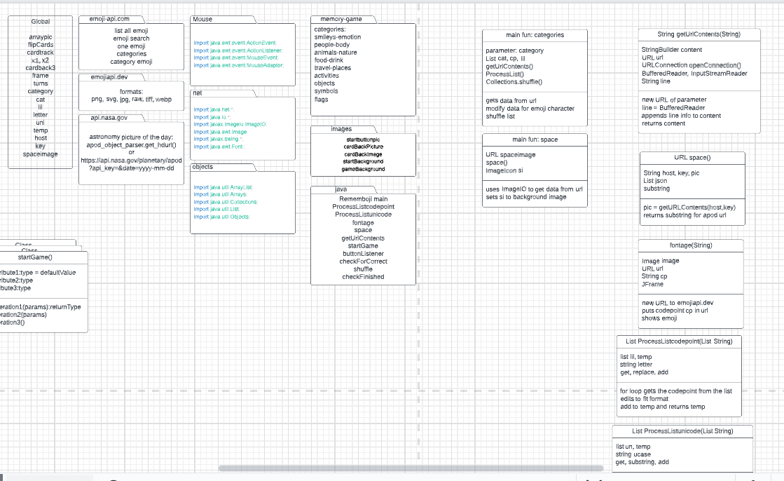
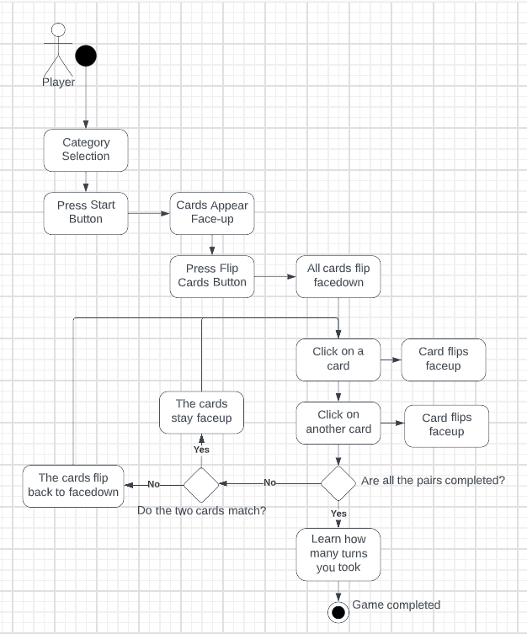
Lessons Learned
Modularize your code to make it easier to change and share
Use of regularly updated diagrams makes it easy to see changes
Lucidchart
Have consistent meetings and establish expectations early
Prepare for unexpected edge cases
I.e Space API can give videos

